Slide 1
Web engineering Lecture 01

Slide 2
Introduction

Slide 3
Web engineering
Web engineering is the study of the process, used to create high quality Web-based applications.
Web engineering draws heavily on the principles and management activities found in software engineering processes.
Web engineering extends Software Engineering to Web applications.

Slide 4
Web engineering
Web engineering is defined as
“The application of systematic and quantifiable approaches to cost-effective analysis, design, implementation, testing, operation, and maintenance of high-quality web applications”

Slide 5
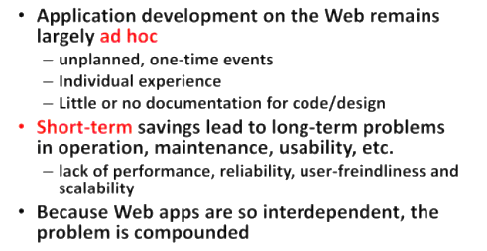
Why web engineering

Slide 6
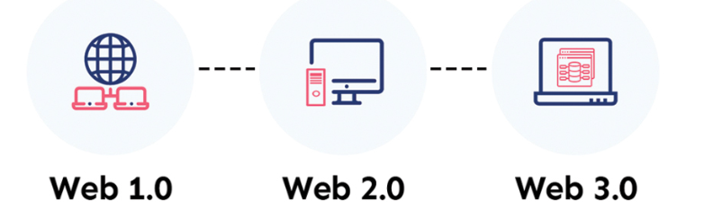
Evolution of world wide web
Globally, billions of people rely on the World Wide Web as their major medium for online communication and information exchange. Since its beginning
World Wide Web has seen significant development from Web 1.0 to Web 2.0, leading to Web 3.0.

Slide 7
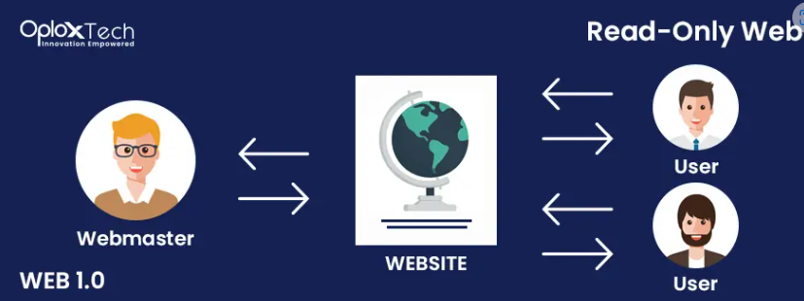
Web 1.0
it was created to facilitate easier information discovery.
This version of the web is commonly referred to as “the read-only Web” since it does not have the requisite forms, images, controls, and interaction seen on the modern Internet.

Slide 8
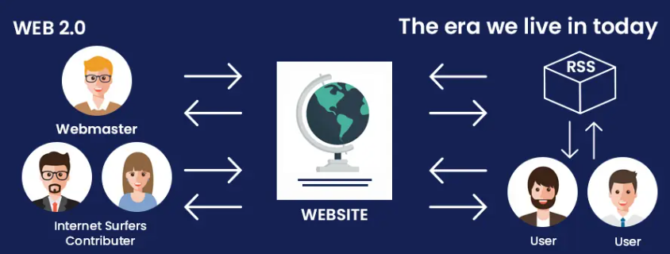
Web 2.0
In Web 2.0 is a lot of people doing a lot of material for a lot of people in comparison with Web 1.0
Web 2.0 encouraged user interaction
The version of Web 2.0 is an improved and expanded version of the World Wide Web that makes use of modern browser features like JavaScript frameworks.

Slide 9
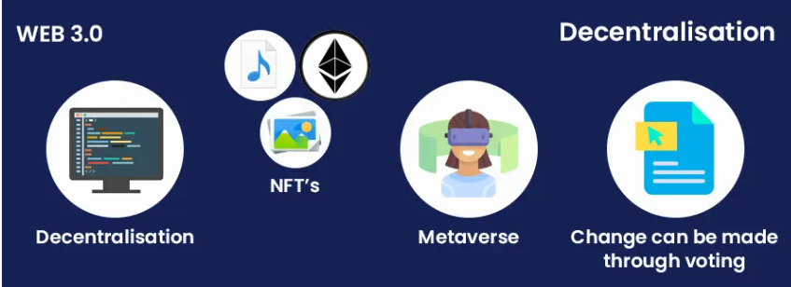
Web 3.0
Web 3.0 (also known as Web 3) is based on the principles of decentralization, openness, and improved user usefulness.
Web 3.0 is the “read, write, execute Web,” whereas Web 1.0 is the “read-only Web” and Web 2.0 is the “participative social Web
Web 3.0 as the Semantic Web and envisioned an intelligent, autonomous, and open Internet that employed AI and ML.

Slide 10
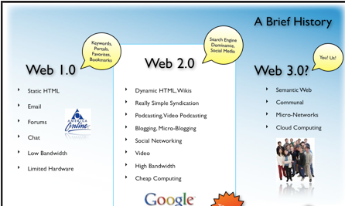

Slide 11
Web applications (Web Apps)
Web Application
A web application is a software system based on technologies and standards of World wide web consortium(W3C) that provides web specific resources such as content and services through a user interface, the web browser.

Slide 12
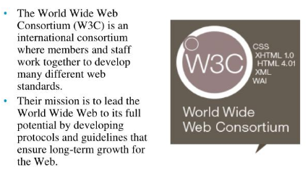
World wide consortium(W3C)
World wide consortium(W3C)

Slide 13
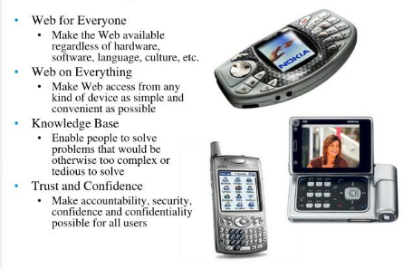
W3C long term benefits
World wide consortium(W3C)

Slide 14
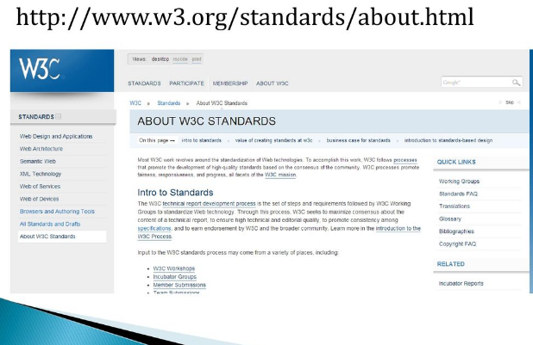

Slide 15
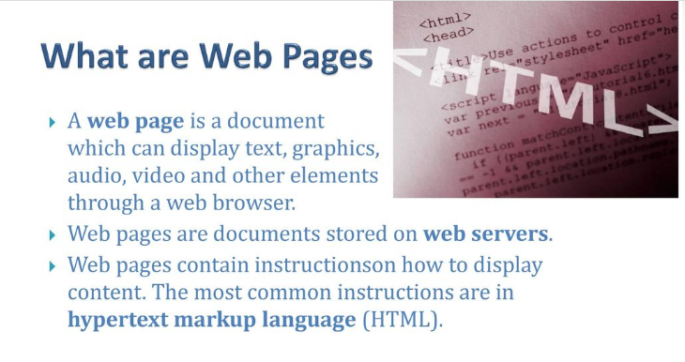

Slide 16
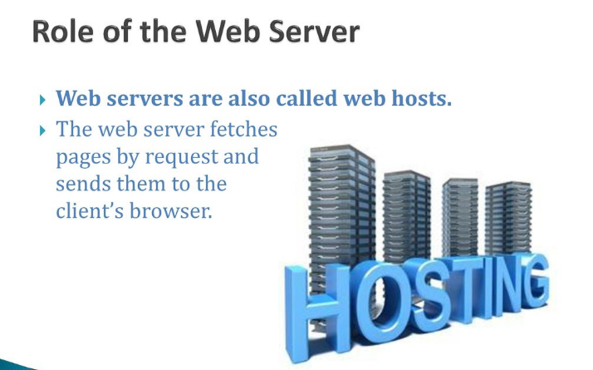

Slide 17
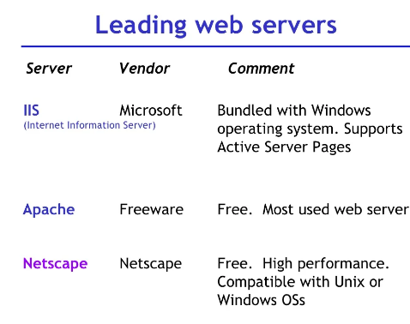
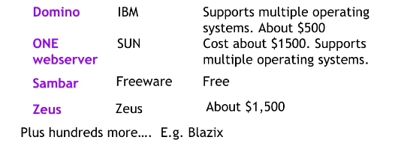

Slide 18
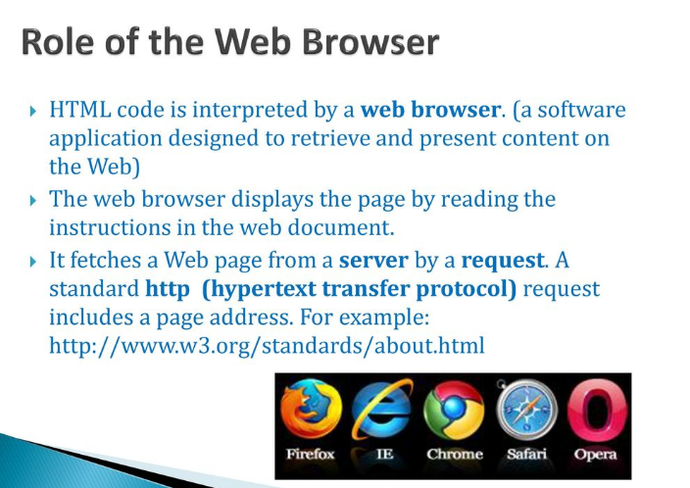

Slide 19
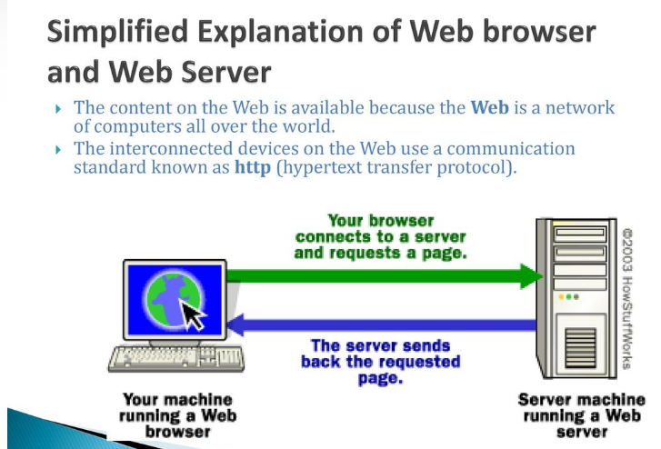

Slide 20

What is the World Wide Web

Slide 21
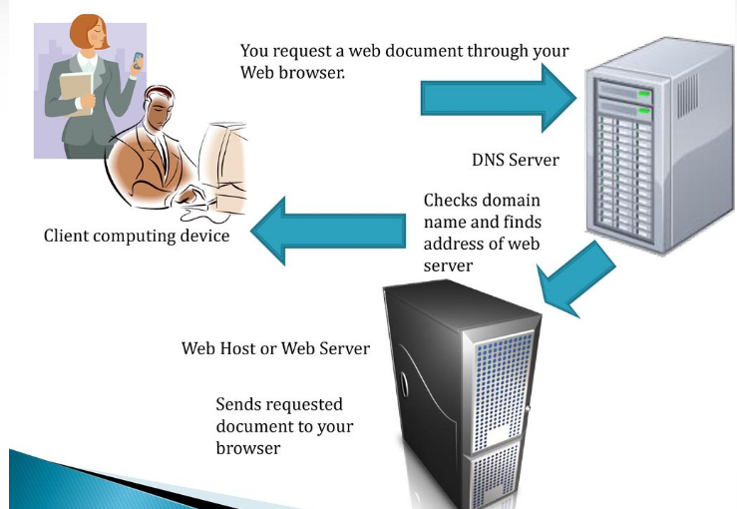
Web page request on web browser and web server

Slide 22
Client-Side
Server-Side
Stuff happening on your computer independently of the server
Browser,HTML,CSS .... Also called front-end
Requests being fulfilled by a server
DNS,API,CMS ...
Also called back-end

Slide 23
Client-Side Technology

Slide 24
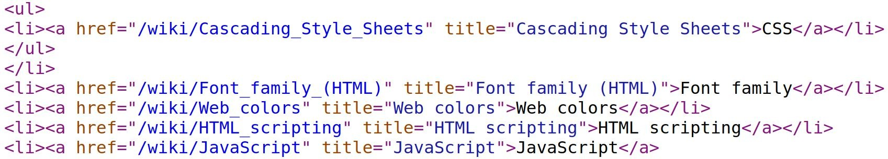
HTML
HTML (HyperText Markup Language) is a special type of computer language called a markup language designed to specify the content and structure of web pages (also called documents) in a portable manner.
HTML5, is the latest version of HTML.

Slide 25
Cascading Style Sheets (CSS)
Although HTML5 provides some capabilities for controlling a document’s presentation, it’s better not to mix presentation with content.
Cascading Style Sheets (CSS) are used to specify the presentation, or styling, of elements on a web page (e.g., fonts, spacing, sizes, colors, positioning).
CSS was designed to style portable web pages independently of their content and structure. By separating page styling from page content and structure, you can easily change the look and feel of the pages on an entire website, or a portion of a website, simply by swapping out one style sheet for another.
CSS3 is the current version of CSS under development.

Slide 26
Javascript
JavaScript helps you build dynamic web pages (i.e., pages that can be modified “on the fly” in response to events, such as user input, time changes and more) and computer applications.
JavaScript is a portable scripting language. Programs written in JavaScript can run in web browsers across a wide range of devices.

Slide 27
Server-Side Technology

Slide 28
PHP
PHP is a server-side scripting language specifically designed for Web applications
A requested document that includes PHP code is preprocessed to interpret the PHP code and insert its output into the HTML document. The browser never sees the embedded PHP code and is not aware that a requested document originally included such code.
PHP provides support for many database management systems.

Slide 29
MYSQL
MYSQL is an open-source relational database management system
Relational database management systems are primarily used to store data organized into one or more tables (or "relations") of columns and rows, with a unique key identifying each row
MYSQL uses SQL (Structured Query Language) for querying and maintaining the database.

